Slide 1
Acupuncture Application

Slide 2
Tools Used
.NET Framework
Microsoft Visual Studio
C#
Microsoft Office Access(Backend)

Slide 3
.NET Framework
A programming infrastructure created by Microsoft for building, deploying, and running applications and services that use .NET technologies, such as desktop applications and Web services.
The .NET Framework contains three major parts:
the Common Language Runtime.
the Framework Class Library.
ASP.NET.
.NET is a programming framework created by Microsoft that developers can use to create applications more easily.
. NET is a layer of software that makes it easier for you to write programs that can communicate with the operating system.

Slide 4
Microsoft Visual Studio
Microsoft Visual Studio is an integrated development environment (IDE) from Microsoft.
It is used to develop computer programs for Microsoft Windows, as well as web sites, web apps, web services and mobile apps.

Slide 5
C#
To start at the very beginning, C# is a modern language created by Microsoft as part of its .NET platform of languages.
C# (pronounced "C-sharp") is an object-oriented programming language from Microsoft that aims to combine the computing power of C++ with the programming ease of Visual Basic.
C# is based on C++ and contains features similar to those of Java.

Slide 6
Microsoft Office Access(Backend)
It is a member of the Microsoft Office suite of applications, included in the Professional and higher editions or sold separately.
Microsoft Access stores data in its own format based on the Access Jet Database Engine.
It can also import or link directly to data stored in other applications and databases.
A back-end Access database is a database that is accessed by users indirectly through an external application rather than by application programming stored within the database itself or by low level manipulation of the data (e.g. through SQL commands).

Slide 7
UI Components

Slide 8
Form
Visual Basic Form is the container for all the controls that make up the user interface.
Every window you see in a running visual basic application is a form, thus the terms form and window describe the same entity.
Every form will have title bar on which the form's caption is displayed and there will be buttons to close, maximize and minimize the form which can be deactivated in the properties.

Slide 9
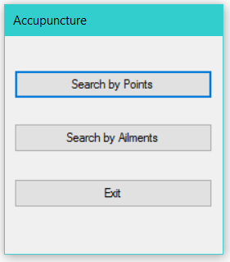
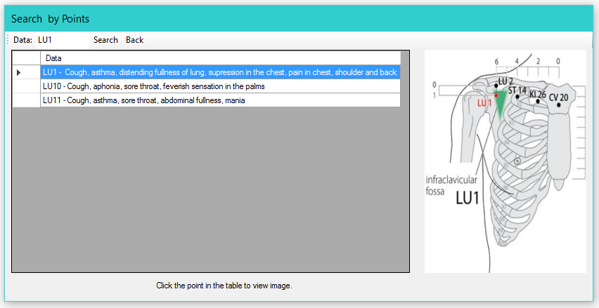
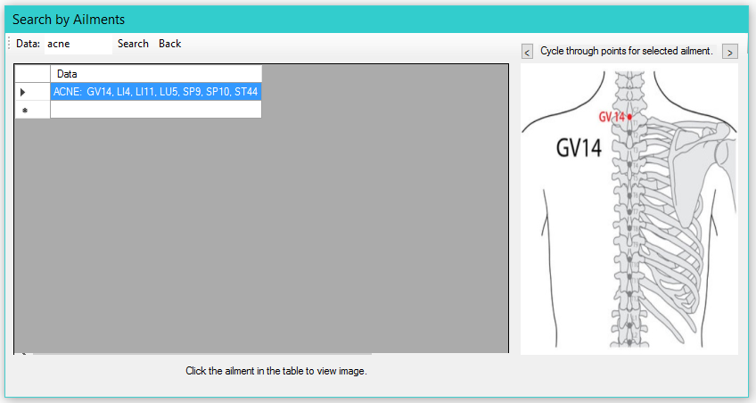

Slide 10
Data Grid View
The DataGridView control provides a powerful and flexible way to display data in a tabular format.
You can use the DataGridView control to show read-only views of a small amount of data, or you can scale it to show editable views of very large sets of data.

Slide 11
Tool Strip
The Windows Forms ToolStrip control and its associated classes provide a common framework for combining user interface elements into toolbars, status bars, and menus.
ToolStrip controls offer a rich design-time experience that includes in-place activation and editing, custom layout, and rafting, which is the ability of toolbars to share horizontal or vertical space.

Slide 12
Button
The Button control represents a standard Windows button.
It is generally used to generate a Click event by providing a handler for the Click event.

Slide 13
Picture Box
The PictureBox control is used for displaying images on the form.
The Image property of the control allows you to set an image both at design time or at run time.

Slide 14
Label
The Label control represents a standard Windows label.
It is generally used to display some informative text on the GUI which is not changed during runtime.

Slide 15
Text Box
Text box controls allow entering text on a form at runtime.
By default, it takes a single line of text, however, you can make it accept multiple texts and even add scroll bars to it.

Slide 16
User Interface
Home Screen

Slide 17
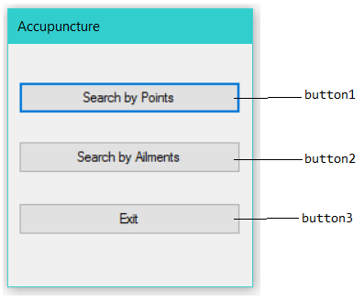
private void button1_Click(object sender, EventArgs e)
{
Form3 frm = new Form3();
frm.Show();
this.Hide();
}
private void button2_Click(object sender, EventArgs e)
{
Form2 frm = new Form2();
frm.Show();
this.Hide();
}
private void button3_Click(object sender, EventArgs e)
{
Application.Exit();
}

Slide 18
Search by Ailments

Slide 19
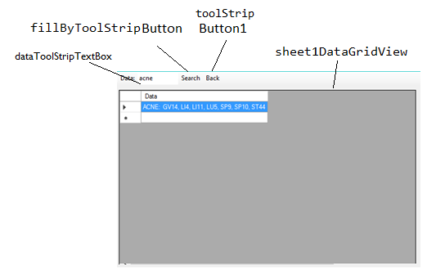
private void toolStripButton1_Click(object sender, EventArgs e)
{
Form1 frm = new Form1();
frm.Show(); this.Close();
}
private void Form2_Load(object sender, EventArgs e)
{
// TODO: This line of code loads data into the 'database1DataSet.Sheet1' table. You can move, or remove it, as needed.
this.sheet1TableAdapter.Fill(this.database1DataSet.Sheet1);
button1.Visible = false;
button2.Visible = false;
label1.Visible = false;
}
private void fillByToolStripButton_Click(object sender, EventArgs e)
{
try
{
this.sheet1TableAdapter.FillBy(this.database1DataSet.Sheet1,"%" +dataToolStripTextBox.Text+ "%");
}
catch (System.Exception ex)
{
System.Windows.Forms.MessageBox.Show(ex.Message);
}
}

Slide 20
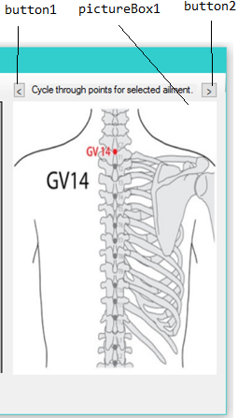
String[] list;
int index=0;
private void sheet1DataGridView_CellContentClick(object sender, DataGridViewCellEventArgs e)
{try
{
button1.Visible = true;
button2.Visible = true;
label1.Visible = true;
int rowindex = e.RowIndex;
DataGridViewRow row = sheet1DataGridView.Rows[rowindex];
String s = row.Cells[0].Value + "";
String s2 = s.Split(':')[1];
String s3 = s2.Split('.')[0];
String[] ll = s3.Split(',');
list = new String[ll.Length];
for (int ii = 0; ii < ll.Length; ii++)
{ list[ii] = ("Resources/" + ll[ii].Trim() + ".jpg").Replace(" ",""); }
Image imgcircle = Image.FromFile(list[0]);
pictureBox1.Image = imgcircle;
}
catch (Exception) { };
}

Slide 21
private void button1_Click(object sender, EventArgs e)
{
try {
index--;
if (index < 0)
index=list.Length-1;
Image imgcircle = Image.FromFile(list[index]);
pictureBox1.Image = imgcircle;
}
catch (Exception) { }
}
private void button2_Click(object sender, EventArgs e)
{try
{
index++;
if (index > list.Length - 1)
index = 0;
Image imgcircle = Image.FromFile(list[index]);
pictureBox1.Image = imgcircle;
}
catch (Exception) { }
}

Slide 22
Search by Points

Slide 23
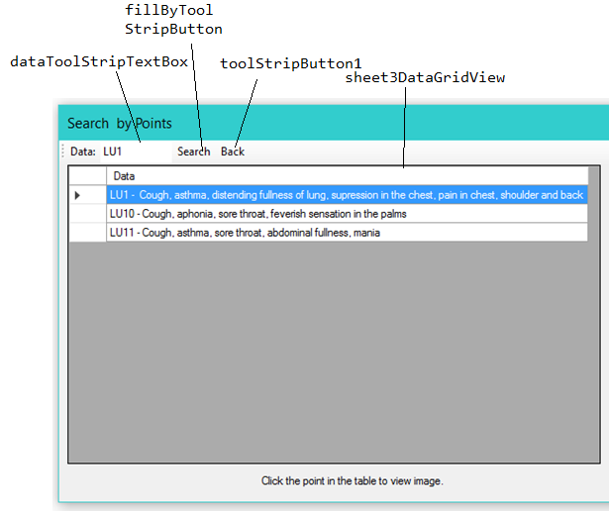
private void Form3_Load(object sender, EventArgs e)
{
// TODO: This line of code loads data into the 'database1DataSet.Sheet3' table. You can move, or remove it, as needed.
this.sheet3TableAdapter.Fill(this.database1DataSet.Sheet3);
}
private void fillByToolStripButton_Click(object sender, EventArgs e)
{
try
{
this.sheet3TableAdapter.FillBy(this.database1DataSet.Sheet3, "%"+ dataToolStripTextBox.Text+ "%");
}
catch (System.Exception ex)
{
System.Windows.Forms.MessageBox.Show(ex.Message);
}
}
private void toolStripButton1_Click(object sender,
EventArgs e)
{
Form1 frm = new Form1();
frm.Show(); this.Close();
}

Slide 24
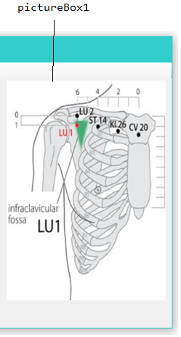
private void sheet3DataGridView_CellContentClick(object sender, DataGridViewCellEventArgs e)
{try {
int rowindex = e.RowIndex;
DataGridViewRow row = sheet3DataGridView.Rows[rowindex];
String s = row.Cells[0].Value + "";
String s2 = s.Split('-')[0];
//MessageBox.Show(s2.Trim());
string path = ("Resources/" + s2.Trim() + ".jpg").Replace(" ", "");
// MessageBox.Show(path);
Image imgcircle = Image.FromFile(path);
pictureBox1.Image = imgcircle;
// MessageBox.Show(s2);
}
catch (Exception) { }
}

